Slide 1
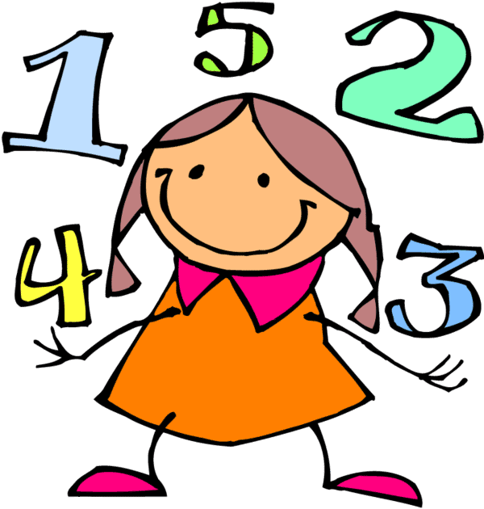

Maths information for YR parents

Slide 2
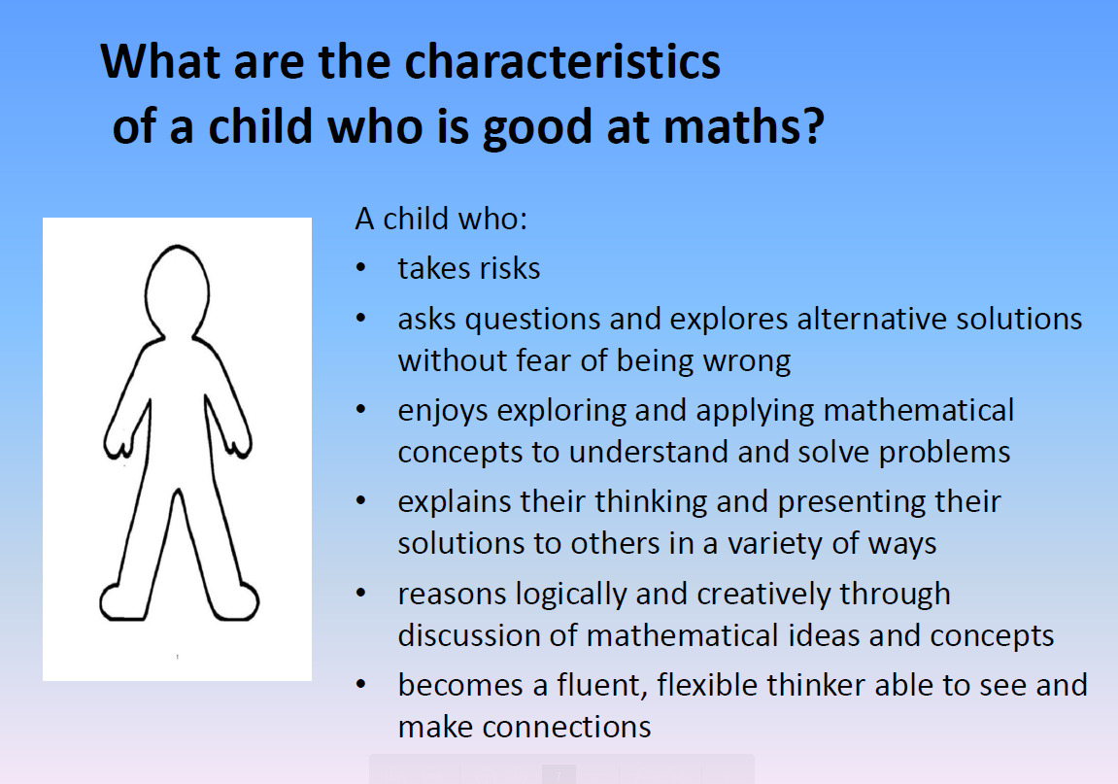

Slide 3
How children learn mathematics
E Experience with physical objects,
L spoken Language that describes that experience
P Pictures that represent the experience,
S written Symbols that generalise the experience

Slide 4
Key skills by end of YR
Count reliably with numbers from 1 – 20
Place the numbers from 1 to 20 in order
Say which number is one more or one less than a given number
Add two quantities together (to 20 – using objects)
Subtract one quantity from another (to 20 – using objects)
Counting on (addition) to find the answer
Counting back (subtraction) to find the answer
Solving problems (including halving / doubling)
Describe 2-D and 3-D shapes
Describe position e.g. in front of , behind and quantities e.g. heavier, bigger, greater

Slide 5
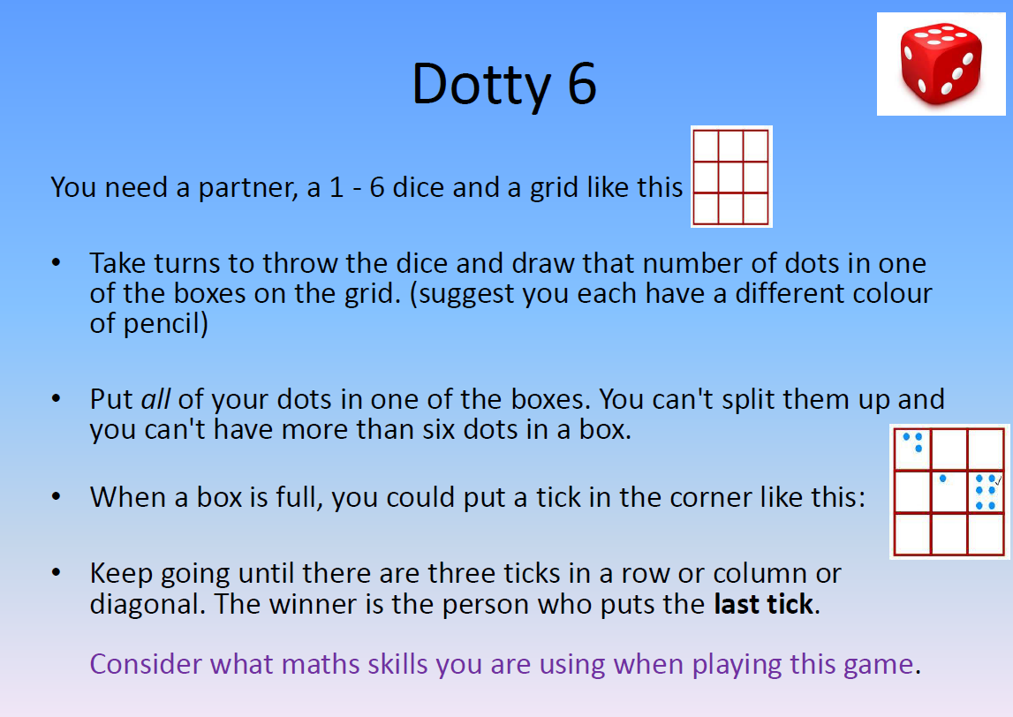

Slide 6
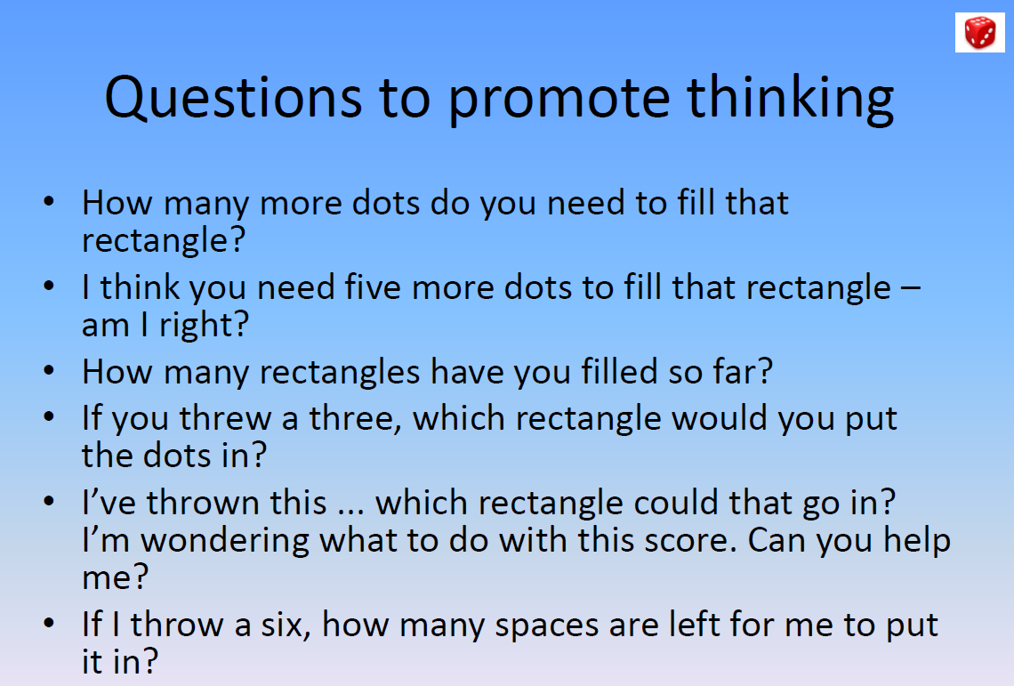

Slide 7
Counting
Children need to construct their understanding of the number system

Slide 8
Then what happens??
eleven…
twelve…
The tricky teens…
“Spotting a pattern is at the heart of mathematical thinking….”

Slide 9
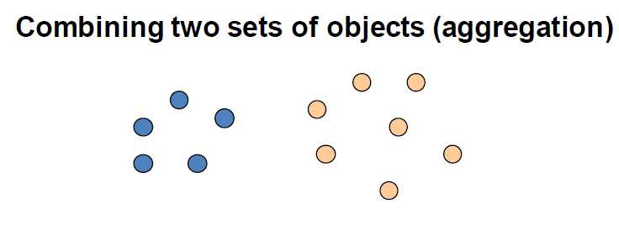
Addition

Slide 10
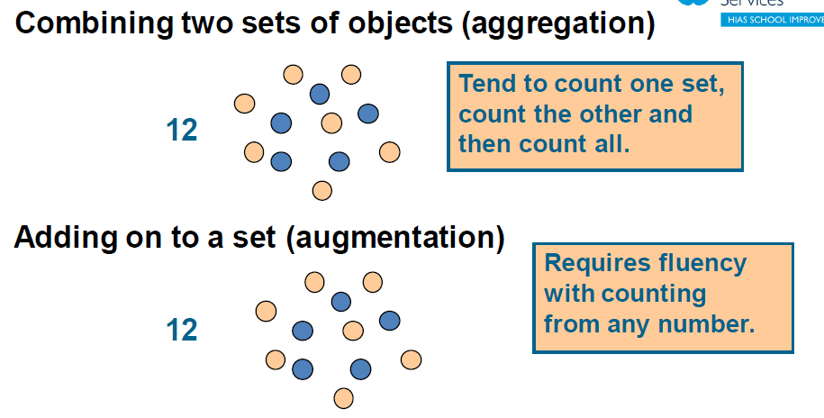
I know I have 5 blue counters and I will count on the rest e.g. 6,7,8,9,10,11,12

Slide 11
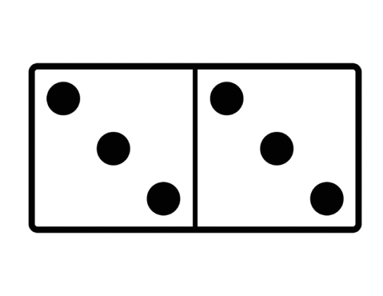
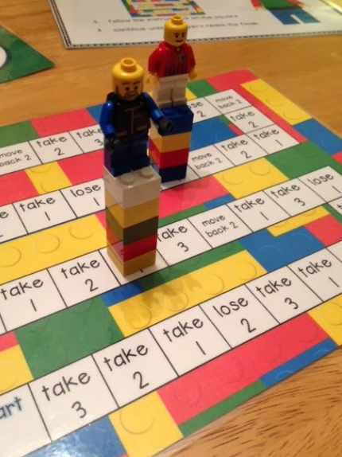

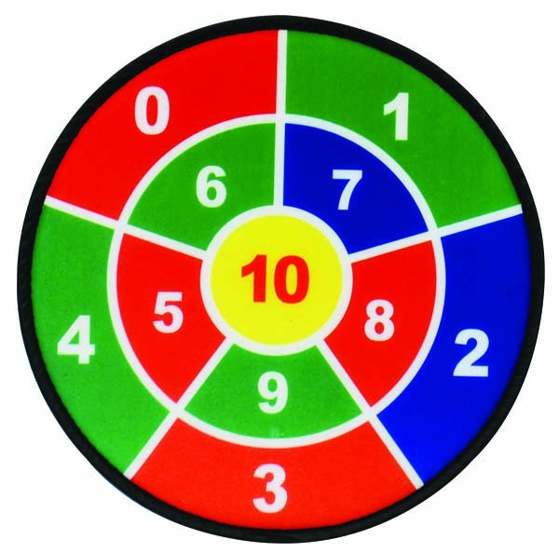
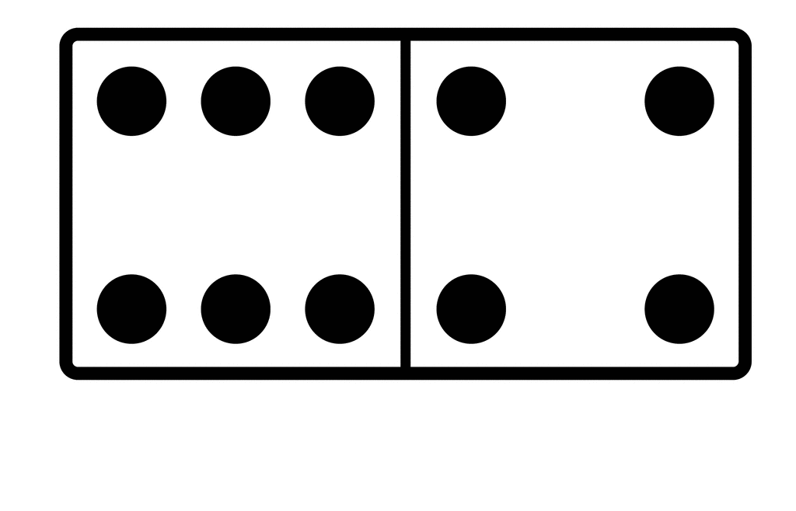
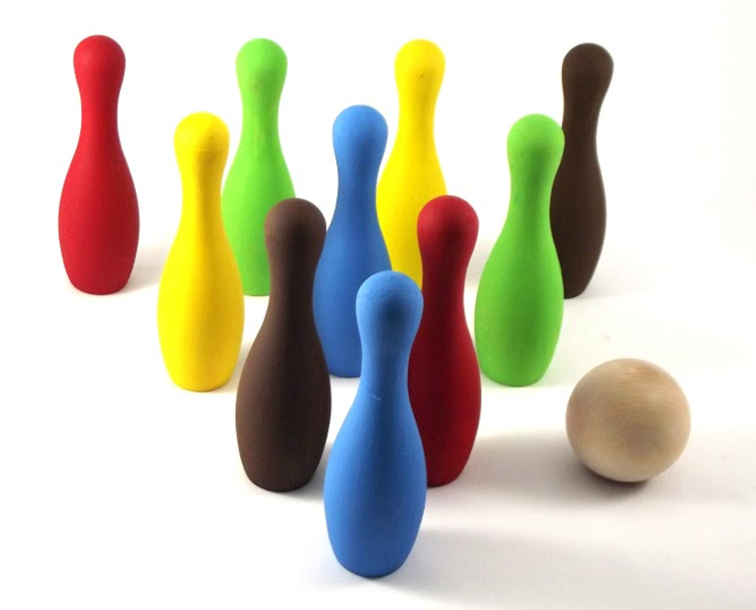
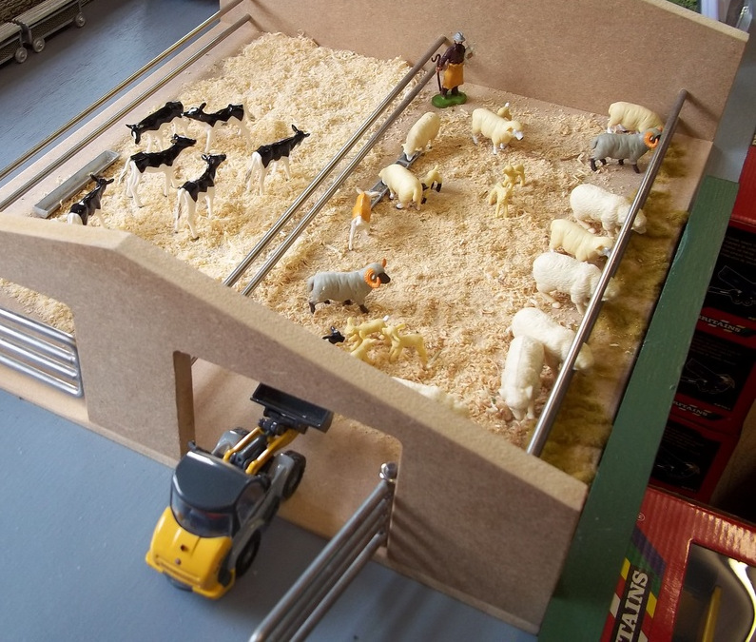

Slide 12


Subtraction
Start with a set of objects, take some away, count those left.
How many apples do we have. Take 2 away. How many apples do we now have?

Slide 13
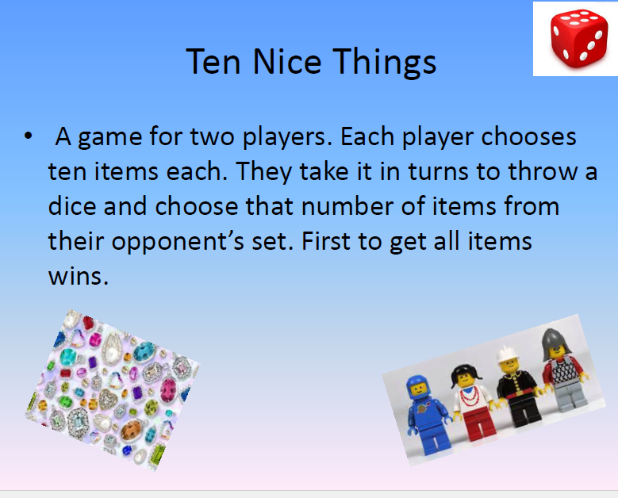

Slide 14

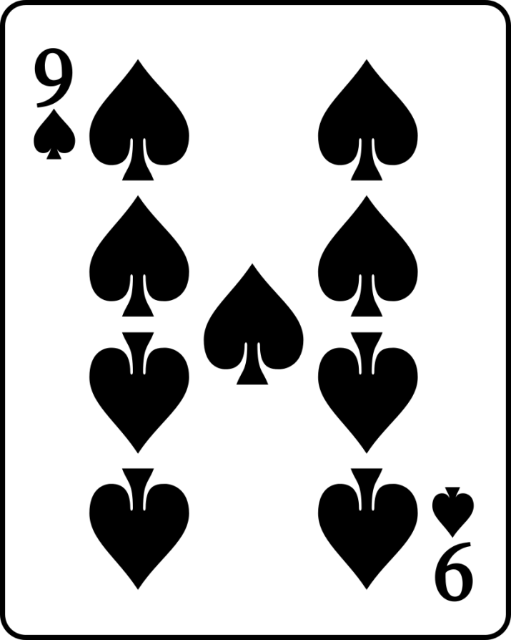

One more, one less
Don’t do 1 less than 0!
Find the card that is 1 more

Slide 15
One more…one less
If there are 8 turtles, how many would there be if one more comes along?
What is the number that is one more than 12?
If I have 15 counters and you have one less than
me, how many do you have?
What is the number that is one less than 18?

Slide 16
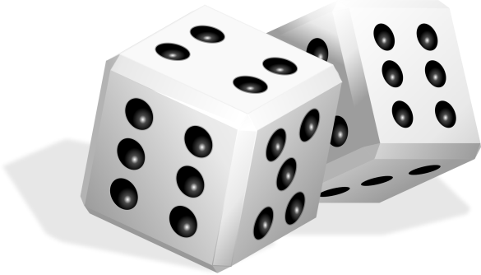
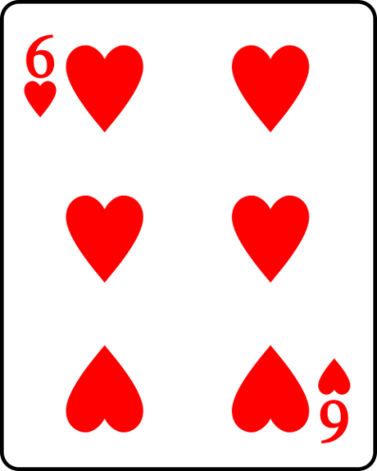
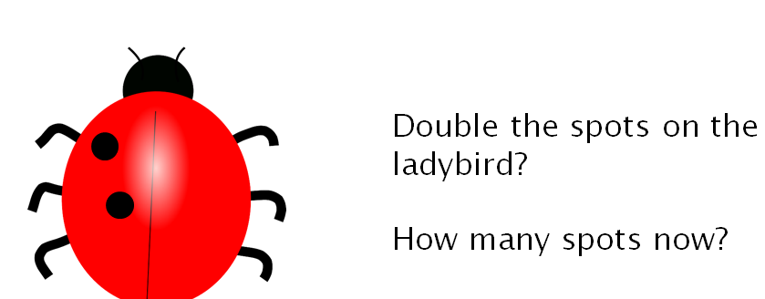
Doubles
Introduce the idea of “double”.
Dice games are good for this!
Use “snap” games with playing cards / digit cards.
Finding matching pairs

Slide 17


Shape and space
Beginning to use mathematical names for ‘solid’ 3D shapes and ‘flat’ 2D shapes and mathematical terms to describe shapes.
2D: triangle, square, rectangle, circle, pentagon, hexagon
3D:cube, cuboid, sphere, cylinder, cone, pyramid
Selects a particular named shape – from a group of shapes, eg where is the square? Can you show me a cube?

Slide 18
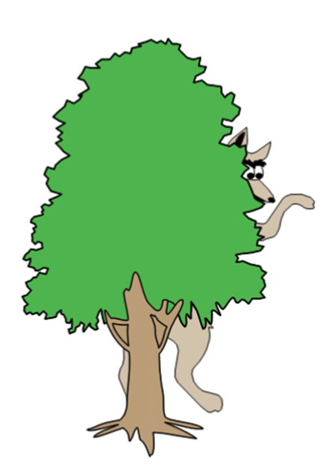
Can describe their relative position such as ‘behind’ or ‘next to’ Also ‘under’, ‘above’, ‘left’, ‘right’, ‘on’, ‘off’ , ‘in front of’ Playing ‘hide and seek’ is good for this eg ‘I was under the table’, ‘I was in front of the bush’
Look at pictures in books.
Where is the wolf?
Is he in front of the tree?

Slide 19
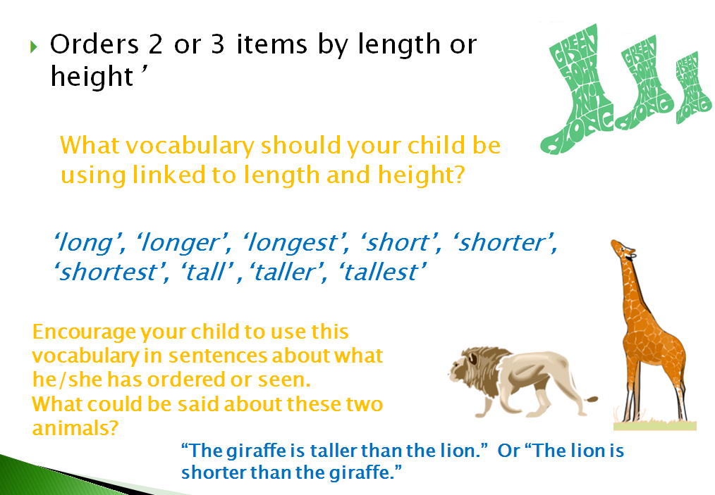

Slide 20
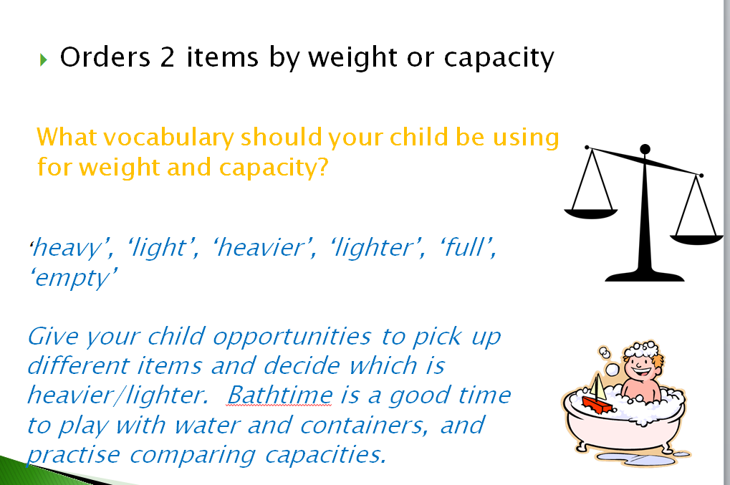

Slide 21
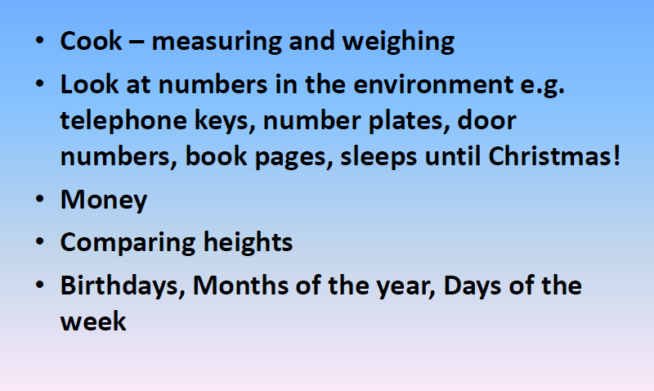
Other ways to help at home…

